Slide 1


Where is the best zip code to buy a home using the Price to Rent Ratio? Comparing zip codes in the U.S. with high rent and low home sale prices
Vishwa Angampalli
Lindsay Hopewell
Rajiv Manglani
Junki Ogawa
Notes:
How we decided on this topic

Slide 2
The Price to Rent Ratio = (Median Sale Price)/(Median Annual Rent)
Lower Price-to-Rent ratio
More favorable for buyers
Higher Price-to-Rent ratio
Better environment to renters
Purpose of our project:
Visualize the best places to buy and rent based off of the Price to Rent Ratio
Notes:
The price-to-rent ratio is the ratio of home prices to annualized rent in a given location. This ratio is used as a benchmark for estimating whether it's cheaper to rent or own property. The price-to-rent ratio is used as an indicator for whether housing markets are fairly valued, or in a bubble.

Slide 3
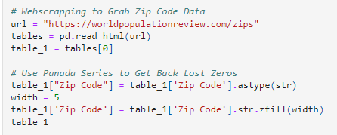
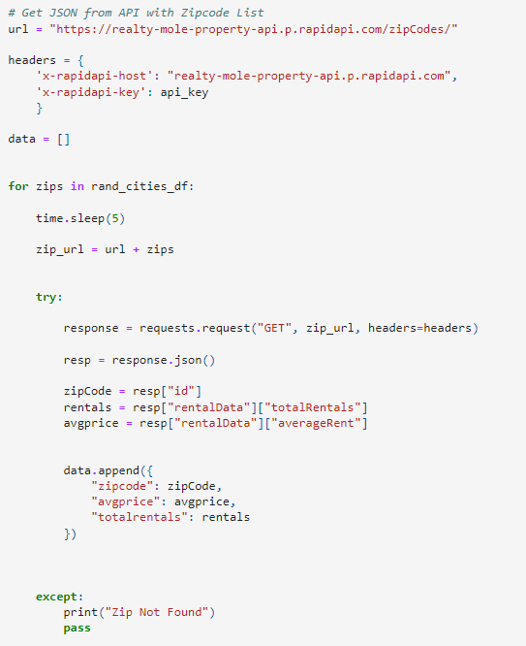


Data Sources and Extraction
Worldpopulationreview.com
Webscraping with Pandas
Realtymole.com – API
https://www.redfin.com/news/data-center/
CSV
Notes:
Add snips
Add our challenges and where we got stuck
CLICK TO SHOW IMAGES

Slide 4
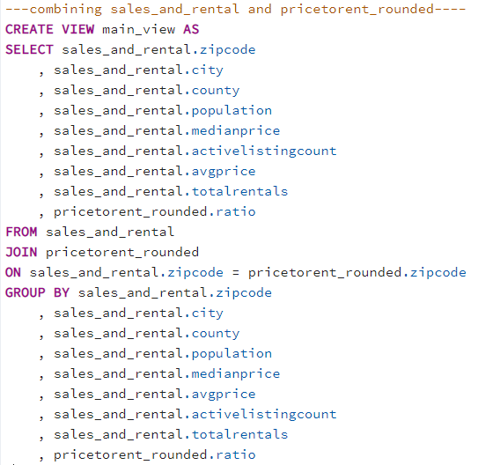
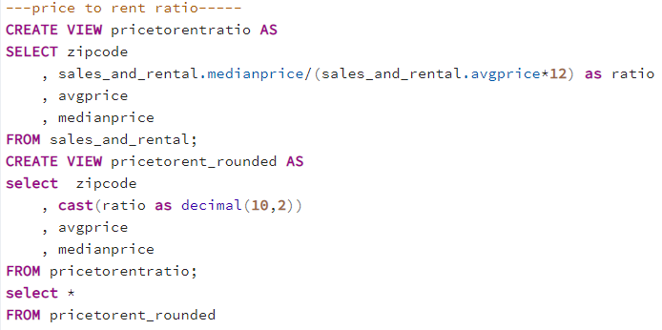
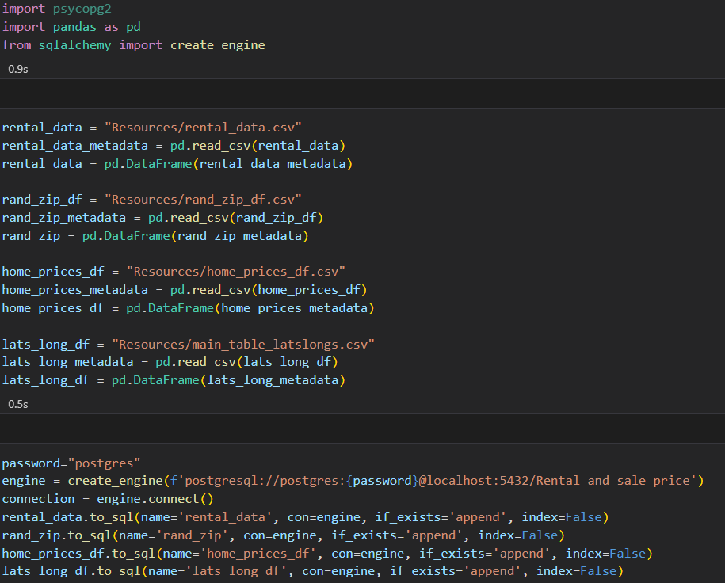
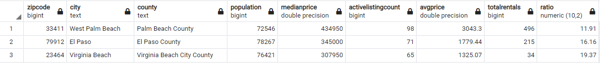
Data Transformations
Sqlalchemy to convert to CSV
SQL with Postgres
JOIN on zip code as the Primary Key
Created main view with full data set to be used
Created new column for the Price to Rent Ratio
Created new table to use in Flask
Convert zip codes to longitude and latitude
pip install pgeocode
Notes:
Add snips
Add our challenges and where we got stuck
CLICK TO SHOW IMAGES

Slide 5
The Coding Approach
Flask
One of our bigger hurdles of this project – connecting Flask to javascript
JavaScript
Leaflet - map the zip codes and visualize the Price to Rent Ratio
HTML and CSS
Bootstrap – Cards to show top 5 and bottom 5 areas to buy and rent
CSS – style the legend
Plot.ly
Bar graph to visualize the population and their Price to Rent Ratio
Notes:
Add snips

Slide 6
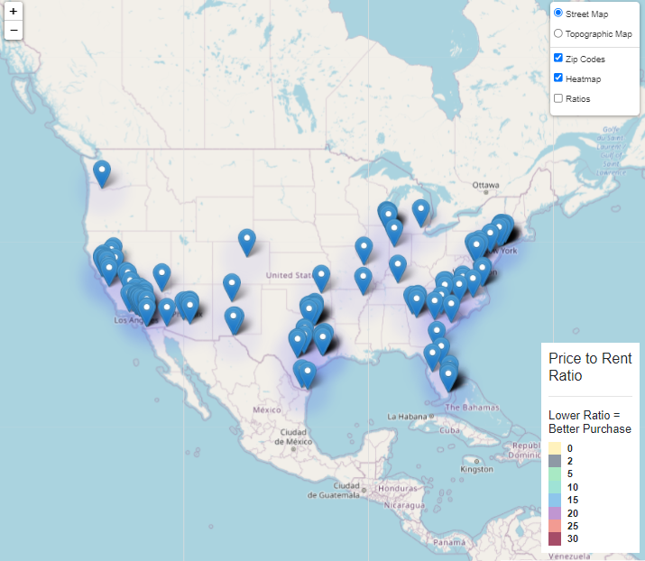
Javascript, Plot.ly, and Interactive Map

Slide 7
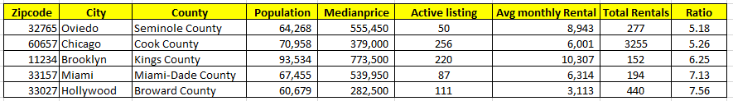
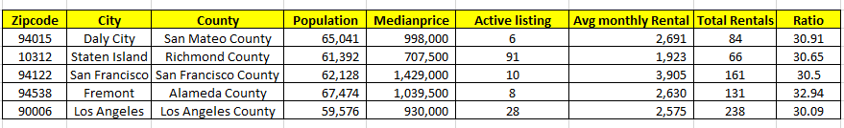
Analysis
Top 5 cities with lowest Price to Rent Ratio – 3 cities in FL
Bottom 5 cities with highest Price to Rent Ratio – 4 cities in CA

Slide 8
Opportunities and limitations
Get more useable data
Don’t forget to get data with lon/lat to map on Leaflet
Get broader data
Our data sets were specific – it required us to get more data sets and create more Joins
Connecting Flask to JavaScript
Notes:
Add snips

Slide 9
Next steps for further analysis
Explore other variables that effect home sale and rent costs
Opportunities to consider:
Future forecasting of local housing market
Property tax rate, interest rate, etc
Trends in WFH and local migration
Home sale and rental prices have rapidly changed in the past two years
While all our data sources were dated from in the past 3 months, we’re not sure how frequently our data sources are updating their information
Notes:
Add snips

